Slide 1
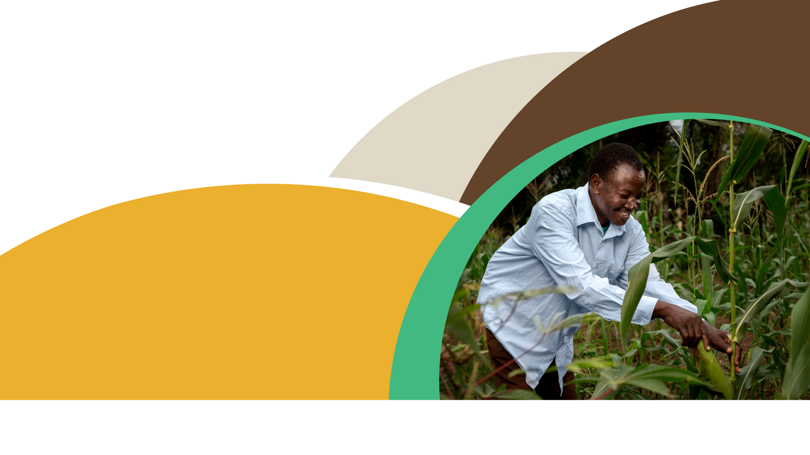
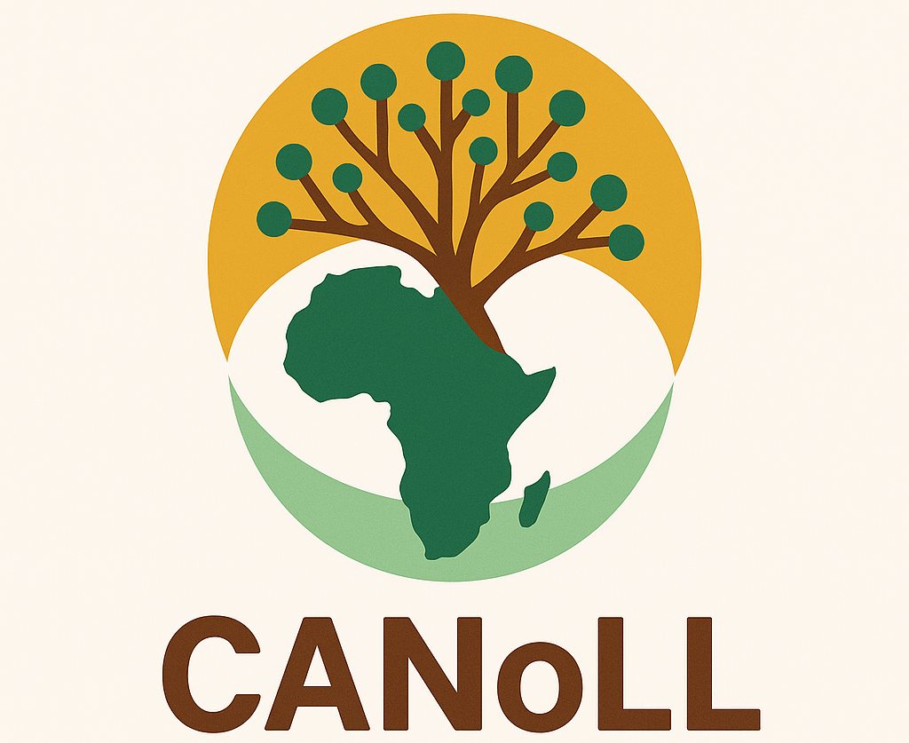


Central and Eastern African Network of Agro-Ecological Living Laboratories
Funded by the European Union under GA no. 101083653. Views and opinions expressed are however those of the authors only and do not necessarily reflect those of the European Union or REA. Neither the European Union nor the granting authority can be held responsible for them.

Slide 2

What is CANoLL
The Central and Eastern African Network of Agro-Ecological Living Laboratories (CANoLL) is a regional platform that connects Agroecology Living Labs (ALLs) to co-create, test, and share agroecological innovations. It addresses challenges such as food insecurity, biodiversity loss, climate change, and unsustainable farming by promoting ecologically sound practices.
Goal
To strengthen collaboration, foster knowledge exchange, empower communities to adopt sustainable solutions, and ensure the long-term sustainability of Agroecology Living Labs beyond individual projects.
October 2025
CANALLS | First Co-creation Cycle

Slide 3
Objectives of CANoLL
Link and coordinate Agroecology Living Labs (ALLs).
Facilitate knowledge sharing and training.
Enhance agroecological research and innovation.
Build and improve resilience, sustainability, and productivity.
Governance and operations
General Coordinator: Oversees daily operations.
CANoLL Board: Provides strategic direction and oversight.
Steering Committee: Composed of technical experts, offering guidance while ensuring inclusivity, transparency, and collaboration.
October 2025
CANALLS | First Co-creation Cycle

Slide 4
Key projects…..
CANALLS: Driving agroecological transitions in the humid tropics (Cameroon, Burundi, Rwanda, DRC).
GALILEO: Agroforestry innovations for resilience, adaptation, and biodiversity.
LVAD: Sustainable intensification of food crops (Cameroon).
Membership criteria
Capacity for research and community engagement.
Proven track record in sustainability initiatives.
Commitment to collaboration and training.
Financial and resource stability.
Openness to innovative initiatives.
October 2025
CANALLS | First Co-creation Cycle

Slide 5
Strategy and growth plan
2025 Priorities: Establish governance structures, strengthen coordination, develop digital platforms, build partnerships, and implement a monitoring and evaluation system.
Long-term Vision: Scale impact, secure sustainable resources, and integrate new members across the region.
Perspectives
CANoLL envisions a resilient, inclusive, and sustainable agricultural future in Central and Eastern Africa. By bridging traditional knowledge and scientific research, CANoLL fosters regional cooperation to drive food system transformation.
October 2025
CANALLS | First Co-creation Cycle

Slide 6

End

