Slide 1
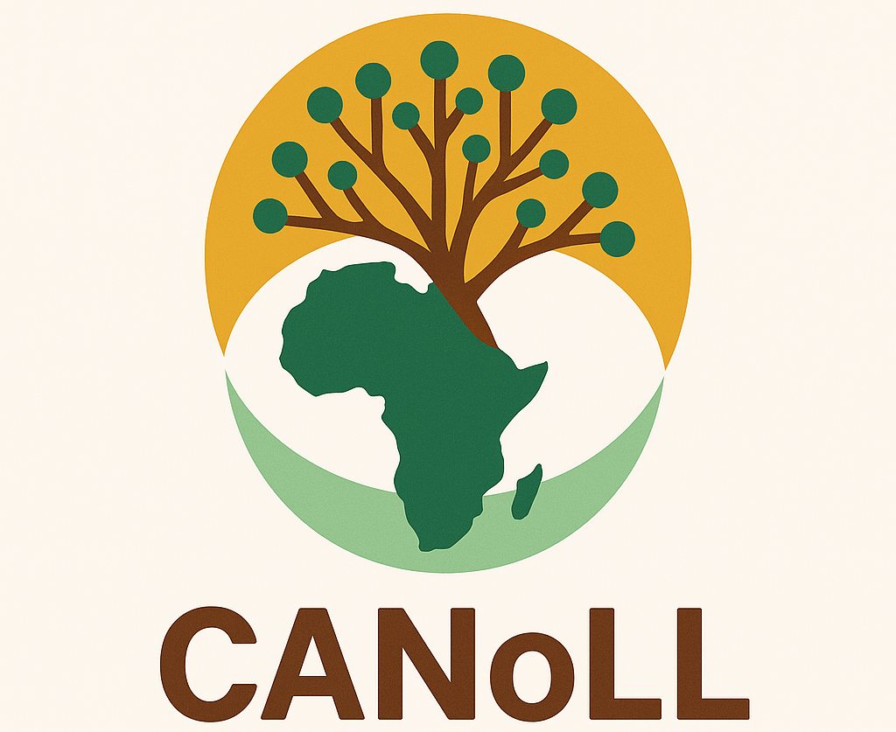

Key projects…..
CANALLS: Driving agroecological transitions in the humid tropics (Cameroon, Burundi, Rwanda, DRC).
GALILEO: Agroforestry innovations for resilience, adaptation, and biodiversity.
LVAD: Sustainable intensification of food crops (Cameroon).
Membership criteria
Capacity for research and community engagement.
Proven track record in sustainability initiatives.
Commitment to collaboration and training.
Financial and resource stability.
Openness to innovative initiatives.
CANALLS | First Co-creation Cycle

Slide 2

Objectives and Approach of each living lab.
Objectives:
To test, monitor & evaluate tailored Agroecology strategies with optimal agroecology practice combinations
ALLs | Farming systems | Research topics | Method/ Approach
Biega & Kabare (RDC) | Coffee | Effect of combinations of AEPs on improvement of coffee bean yield, pests and diseases | Step wise
Bujumbura (Burundi) | Maize | Evaluation of maize-legume intercrop and organic fertilizers and efficacy of biopesticides on FAW | Split plot design
Kamonyi (Rwanda) | Cassava | Effect of agroforestry, Trenches, Fodder grasses on erosion Intercropping cassava with legumes on soil fertility | Stepwise
Ntui (Cameroon) | Cocoa | Effect of foliar fertilization & shading of cocoa trees Effect of biopesticides on disease incidence & population | Mother & baby trials
Uvira (RDC) | Rice | Evaluation of organic and inorganic fertilizers and biopesticides on rice production | Split plot design
19/03/2026
CANALLS | 2nd review meeting, on-line
Notes:
Illustration : <a href="https://storyset.com/people">People illustrations by Storyset</a>
Photo : Photo by Albert Dera on Unsplash

